Slide 1

An Automated COVID-19 SOPs Monitoring And Management System
GSN: FALL 21-18
Presented by:
Maaheen Yasin (L18-1267)
Inbisat Mudassar Dar (L18-1283)
Ahmad Tameem Kamal (L18-1358)
Advisor: Mr. Hamza Yousuf
Client: Saleem Steel Industries
Evaluation Committee:
Ms. Shazia Haque
Mr. Zeeshan Asif

Slide 2

Jetson Nano Developer Kit
Setup
OS and Packages Installation
Camera
Demo
Conclusion
CONTENTS

Slide 3
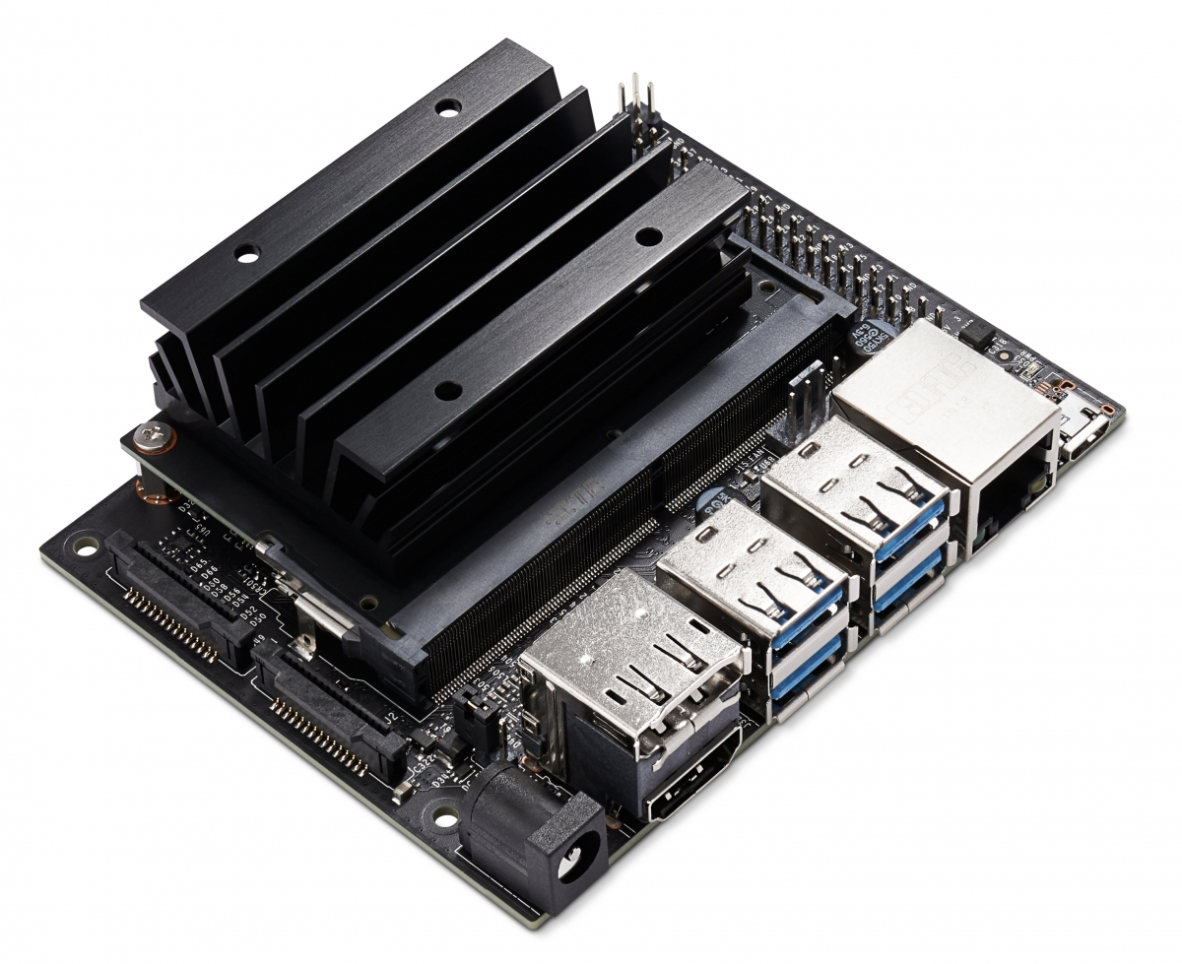
Jetson Nano Developer Kit
Jetson Nano is the powerful small computer specially designed for artificial intelligence
4 USB Ports, HDMI port, 40 pins GPIO
CPU | QUAD-core ARM A57
GPU | 128-core Maxwell
RAM | 4 GB

Slide 4
Setup
The components we are using with Jetson Nano are,
SD Card for OS image and storage
USB camera
USB Keyboard and Mouse
USB Tethering for sharing Internet
5V 3A power adaptor
Monitor for display

Slide 5
OS and Packages Installation
The OS image we are using is JetPack 4.6 which is the specialized version of Ubuntu 18 for Jetson Nano.
It comes with pre install AI packages such as CUDA and OpenCV. Also, the OS is optimized for best performance with the developer kit.
It does not include the TensorFlow and Mediapipe Libraries, which has to be manually installed including each dependencies.

Slide 6
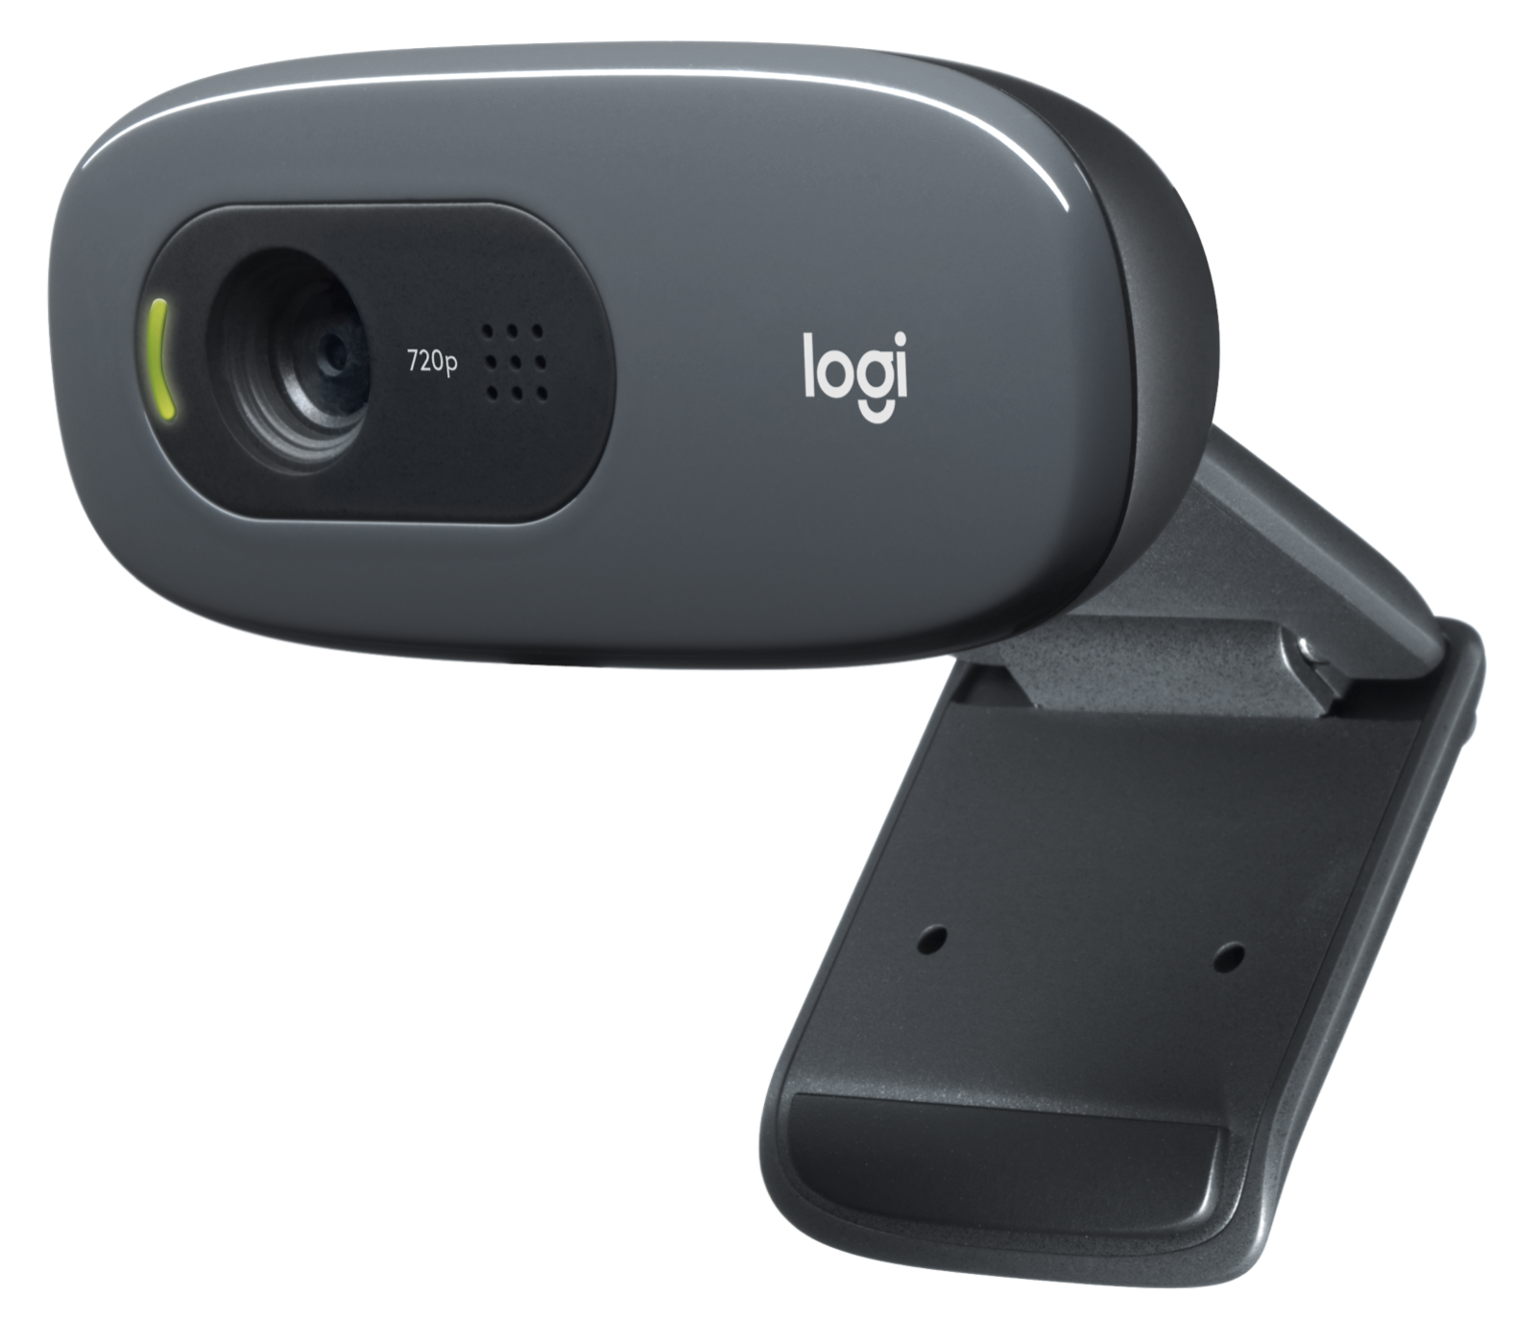
Camera
We are using Logitech USB camera C270 since Jetson does not support the Raspberry Pi v1 camera
The resolution of camera is 720p@30fps
As compare to CSI-camera it is slower but has much
more portability.
Logitech C270 | Pi Camera v2 | Pi Camera v1
720p @ 30fps | 1080p @ 30fps | 1080p @ 30fps
USB | CSI | CSI
55* field | 53* field | 62* field
3MP | 5MP | 8MP

Slide 7
Demo….

Slide 8
Results
The tflite code is tested on jetson nano with stable frame rates and high accuracy
Accuracy achieved with the tensorflow lite model is 92% and it only takes 9.9MB of space.
Model | Accuracy | Loss | Speed | Size | Utilization | RAM
Default Stats | - | - | 16 FPS | - | <10% | 1019 MB
Tensorflow | 0.95 | 0.13 | 4 FPS | 30 MB | >45% | 3182 MB
TFLite | 0.92 | 0.15 | 16 FPS | 9.9 MB | >45% | 1668 MB

Slide 9


